Slide 1
Predicting Accident Severity in the City of Seattle Presented by: Jitendra Kumar Tripathi Oct. 2020

Slide 2
Introduction
In this project I will focus on how to predict accident severity based on different variables such as accident location, time, road and weather conditions and etc.
Advantages include proper emergency response and help commuters plan wisely for their travel
This will be a binary classification where outcomes are accident severity: 1-Property damage and 2-Injury.
Since this is a public safety issue everyone can be interested in this project, specifically municipalities and governments who are key responsible authorities for driving and road safety.

Slide 3
Data acquisition and cleaning
Data includes accidents between 2004-2020 in the city of Seattle. Dataset provides 37 features, however after manipulation and cleaning only the following 21 features are kept to be used for modeling:
[ 'X', 'Y', 'ADDRTYPE', 'COLLISIONTYPE', 'PERSONCOUNT', 'PEDCOUNT', 'PEDCYLCOUNT', 'VEHCOUNT', 'JUNCTIONTYPE', 'SDOT_COLCODE', 'UNDERINFL', 'WEATHER', 'ROADCOND', 'LIGHTCOND', 'SEGLANEKEY', 'CROSSWALKKEY', 'HITPARKEDCAR', 'year', 'month', 'dayofweek', 'Hour']

Slide 4
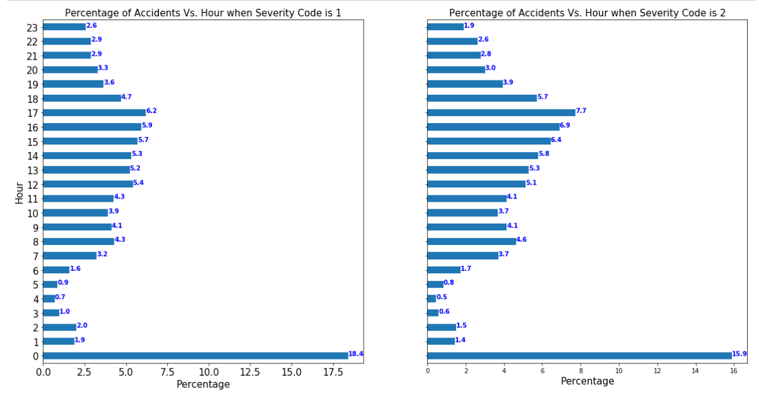
Exploratory Data Analysis Relationship between Hour of the accident and severity
More severe accidents happen during rush hour

Slide 5
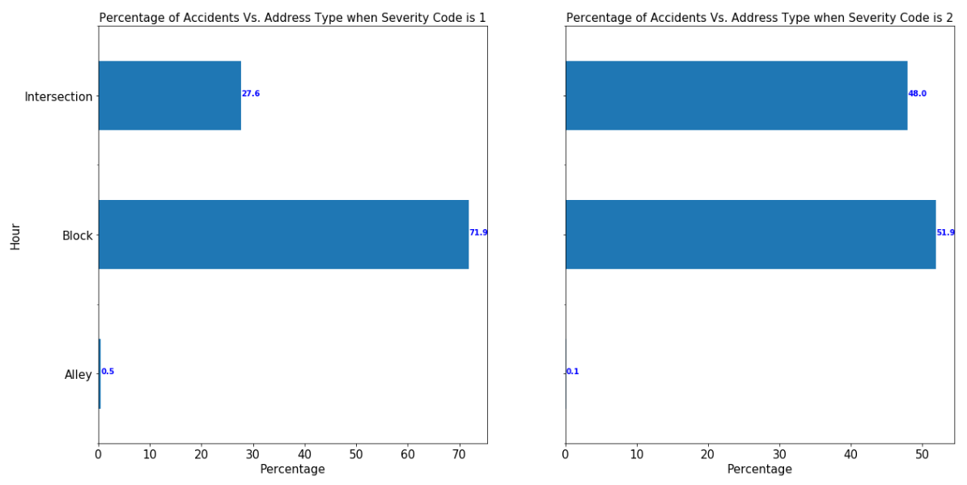
Exploratory Data Analysis Relationship between Address Type and accident severity
More severe accidents happen at Intersections

Slide 6
Predictive Modelling
Four different models have been deployed and the results are compared, including KNN, Logistic Regression, Support Vector Machine (SVM) and Decision Tree.
Model used | F1 Score | Jaccard Similarity Score
Logistic Regression | 0.708 | 0.752
KNN (k=6) | 0.715 | 0.743
Decision Tree | 0.709 | 0.755
SVM | 0.716 | 0.760

Slide 7
Conclusion
In this study, I tried to predict the accident severity based on several features. Binary classification methods have been deployed and the prediction metrics have been confirmed, although all of the predictive models showed similar behavior, SVM results are being slightly superior.

